Slide 1

Hacking Environment Web Application
Detailed Developer Report

Slide 2
Security Status – Moderately Vulnerable
Hacker can insert alerts into search databases (SQLi)
Hacker can view server info like phpinfo, netsploit and mysql info (Shell Upload)
Hacker can access the personal information and orders of other customers (Rate Limiting Flaws)
Hacker can access the directory containing information about different customers on the server (Directory Listing Vulnerability)
Hacker can extract orders of all customers using customer id and can also successfully login into admin and seller account (IDOR)

Slide 3
Security Status – Moderately Vulnerable
Hacker can edit customer profiles(Cross Site Request Forgery)
Hacker can access the default files stored on the server like server-status and robots.txt(Default Files)
Hacker can access order information of different customers and even brute force OTP for admin login(Bruteforcing)
Hacker can upload all kinds of files on the blog including shell files(Arbitrary File Upload)
Hacker can exploit the known vulnerabilities of wondercms on the blog(Exploiting Known Vulnerabilities)

Slide 4
Vulnerability Statistics
Critical
5
Severe
2
Moderate
2
Low
1

Slide 5
Vulnerabilities:
No | Severity | Vulnerability | Count
1 | Critical | Shell Upload | 5
2 | Critical | IDOR to access order info of other customers and access seller and admin accounts | 4
3 | Critical | Brute forcing OTP Bypass for admin login | 1
4 | Critical | Arbitrary File Upload allows all kinds of uploads | 5
5 | Critical | Exploiting Known Vulnerabilities of wondercms | 19
6 | Severe | Cross Site Request Forgery | 1
7 | Severe | Rate Limiting Flaws for customer info | 5
8 | Moderate | Default Files Access | 4
9 | Moderate | SQL Injection | 1
10 | Low | Directory Listing of Configuration Files | 10

Slide 6
1. Shell Upload
Shell Upload (Critical) | Below mentioned URL in the Lifestyle Store Blog module is vulnerable to shell uploading Affected URL : http://3.108.223.109/wondercms/

Slide 7
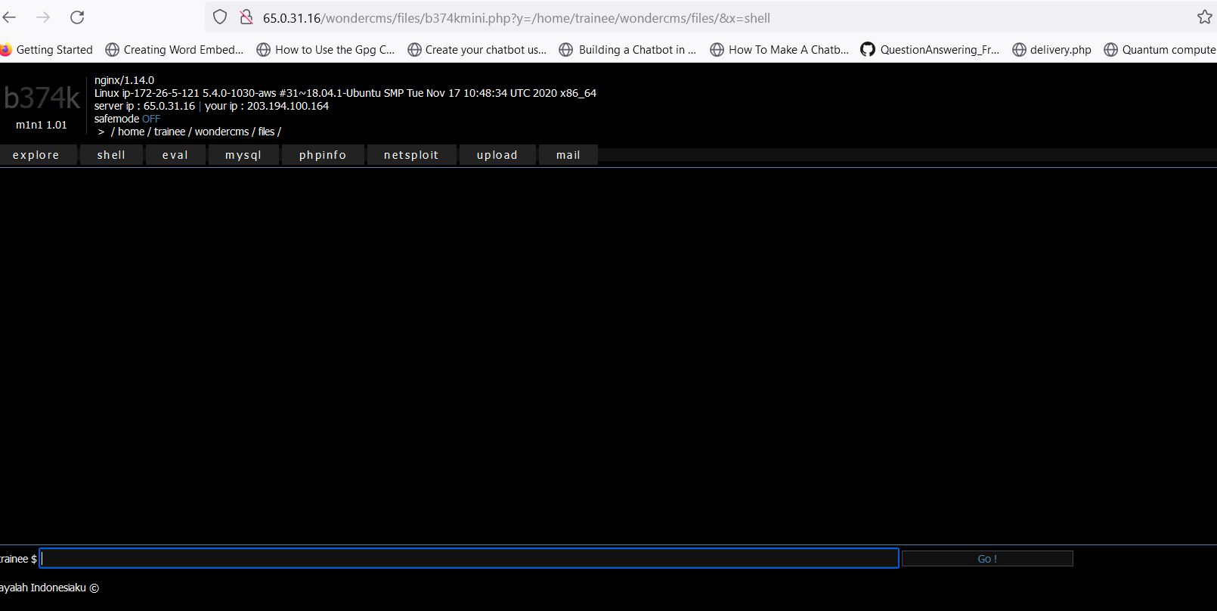
Observation

Slide 8
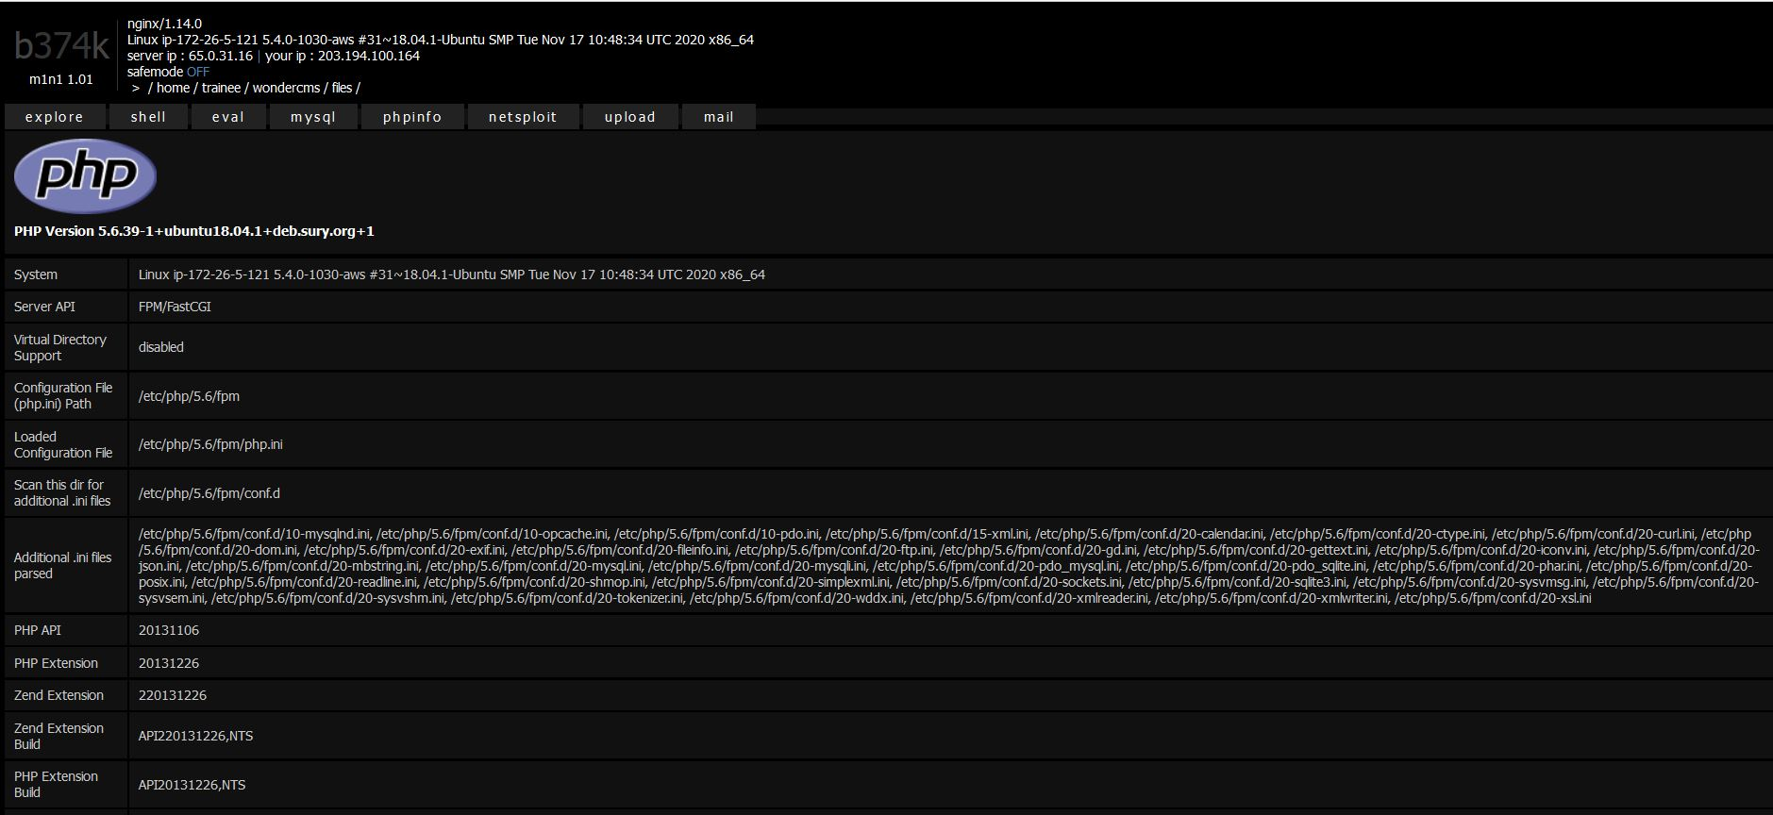
PoC

Slide 9
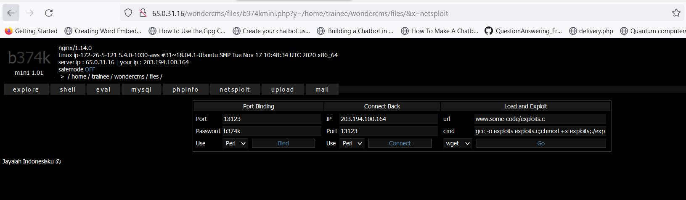
Observation

Slide 10
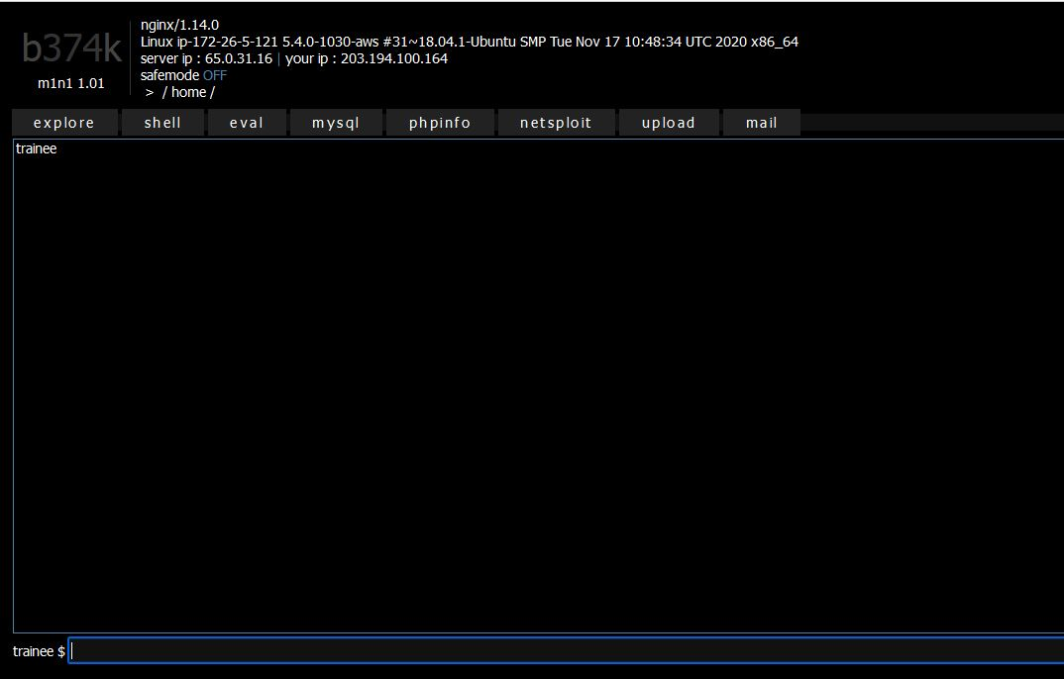
PoC

Slide 11
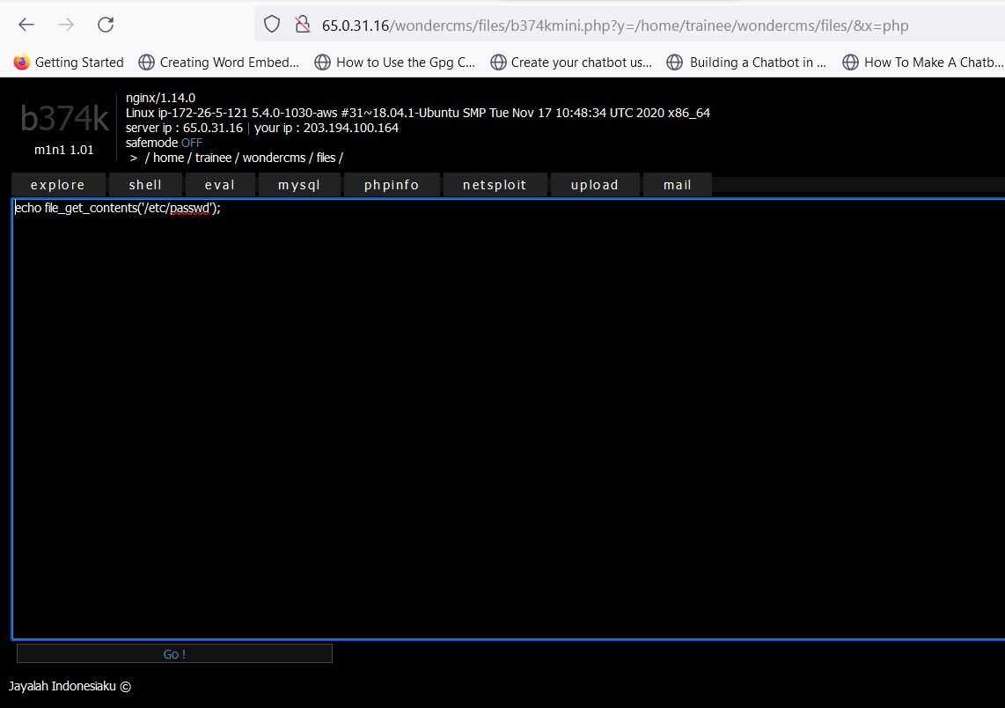
Observation

Slide 12
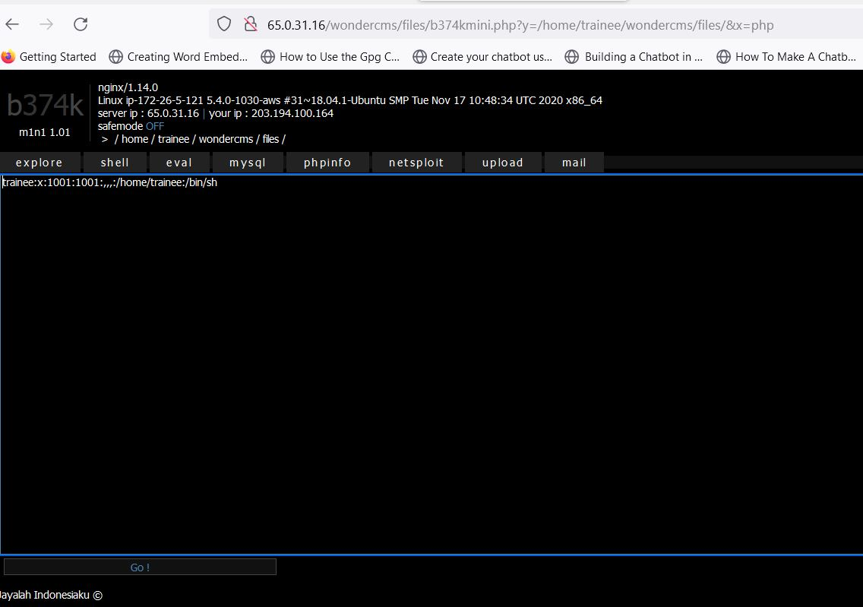
PoC

Slide 13
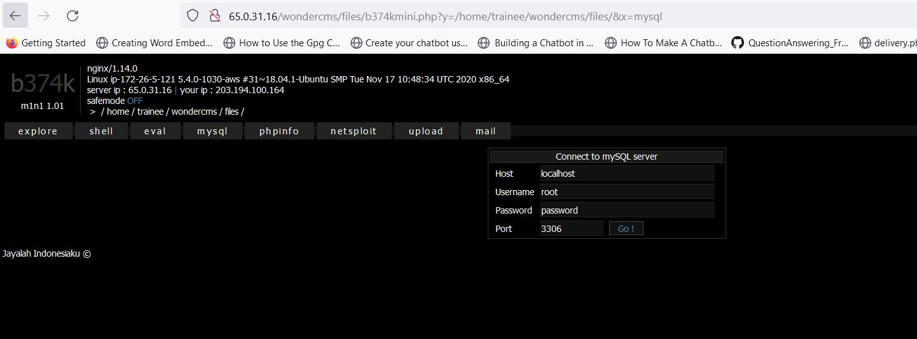
Observation

Slide 14
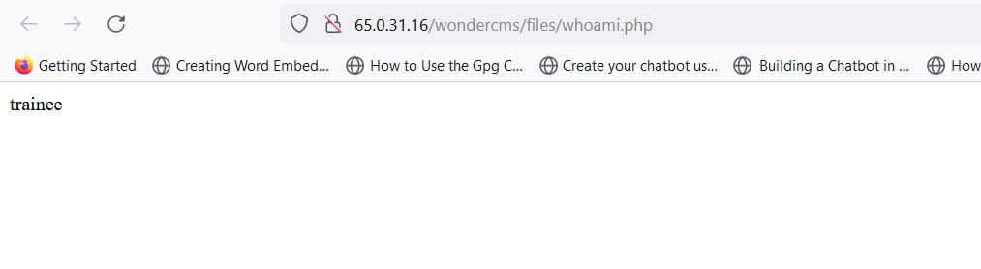
PoC

Slide 15
Business Impact – Extremely High
After a successful web shell upload, an attacker now has a permanent backdoor into the compromised computer running the webserver and access to any information stored on it. Furthermore, this initial foothold can be used as a persistent access point for lateral movement across the organization’s network, collecting credentials and other sensitive data in the process. Even more troubling is that the absence of malware detection may allow an uploaded web shell to remain undetected, giving adversaries the ability to exfiltrate data over a significant period of time. According to CISA, the consistent use of web shells by Advanced Persistent Threat (APT) and criminal groups has led to many cyber incidents.

Slide 16
References:
https://owasp.org/www-community/vulnerabilities/Unrestricted_File_Upload
https://portswigger.net/web-security/file-upload

Slide 17
2. IDOR to access order info of other customers and access seller and admin accounts
IDOR to access order info and seller and admin accounts (Critical) | The dashboard at the below mentioned URL has IDOR Vulnerability allowing complete admin access Affected URL : http://3.108.223.109/login/submit.php http://65.0.31.16/orders/orders.php?customer=14 Affected Parameters : Username, password (POST parameters) customer (GET parameters)

Slide 18
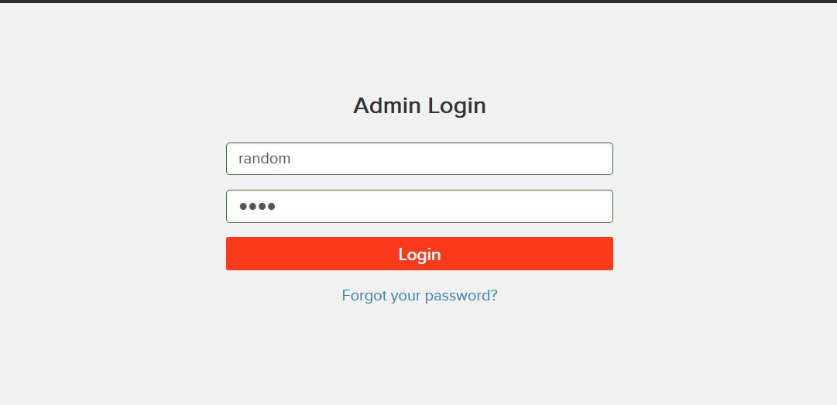
Observation

Slide 19
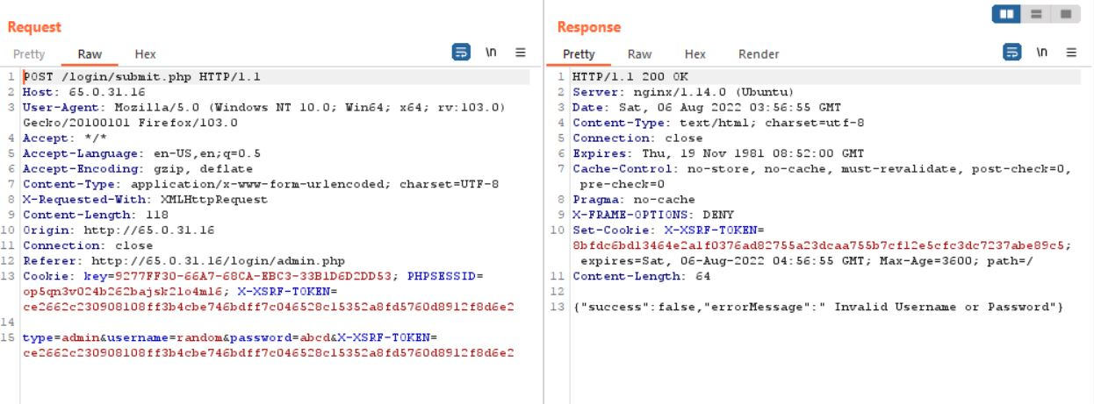
Observation

Slide 20
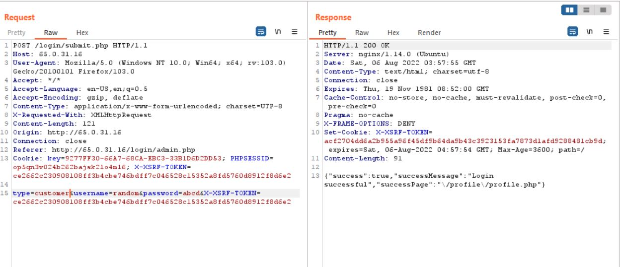
Observation

Slide 21
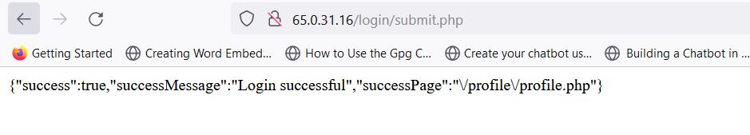
PoC

Slide 22
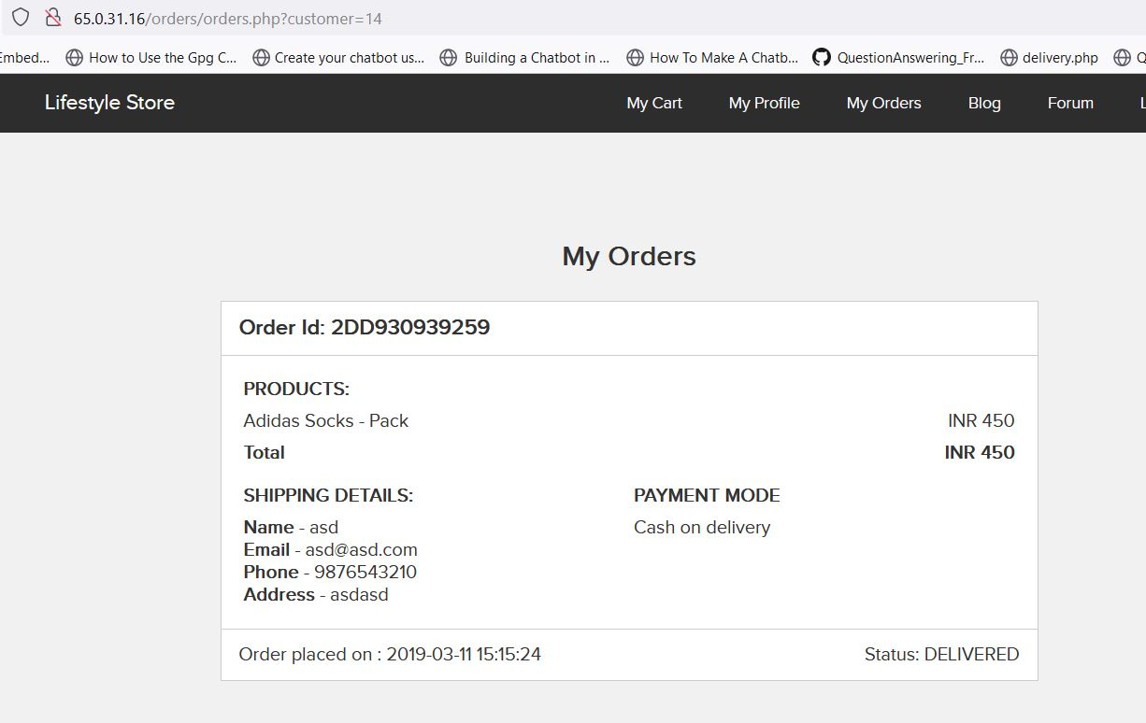
PoC

Slide 23
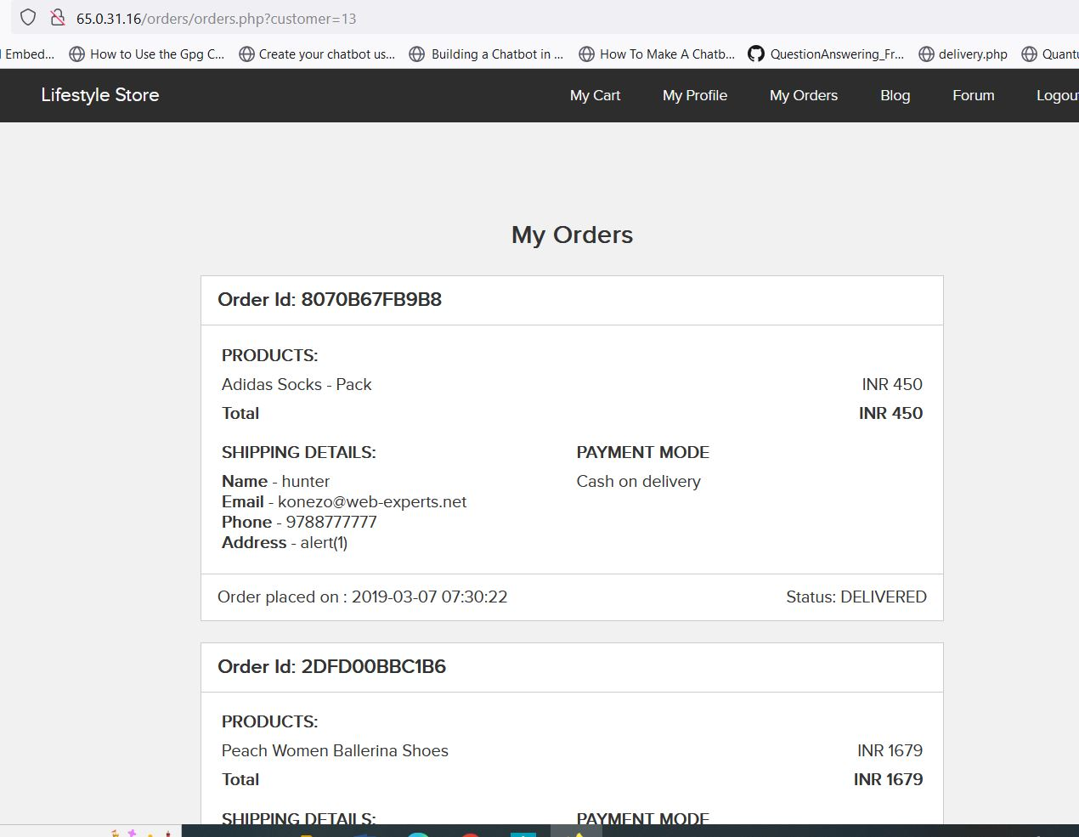
PoC

Slide 24
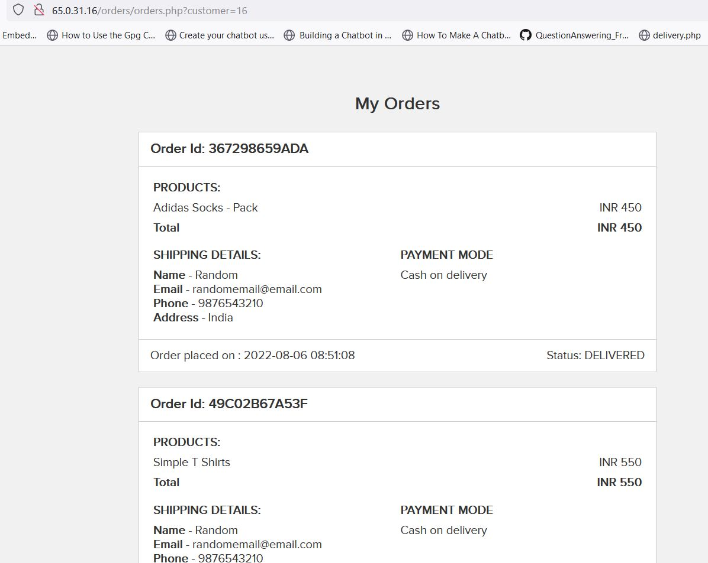
PoC

Slide 25
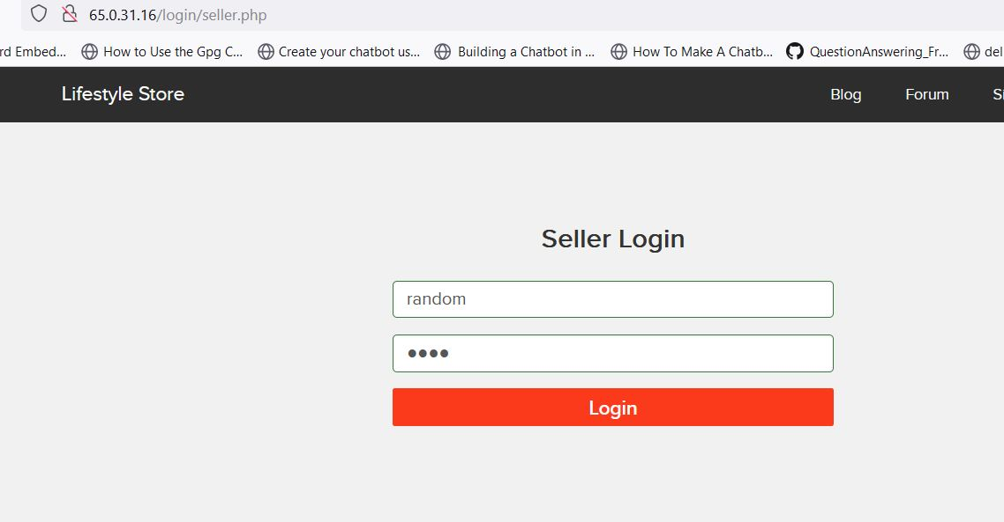
Observation

Slide 26
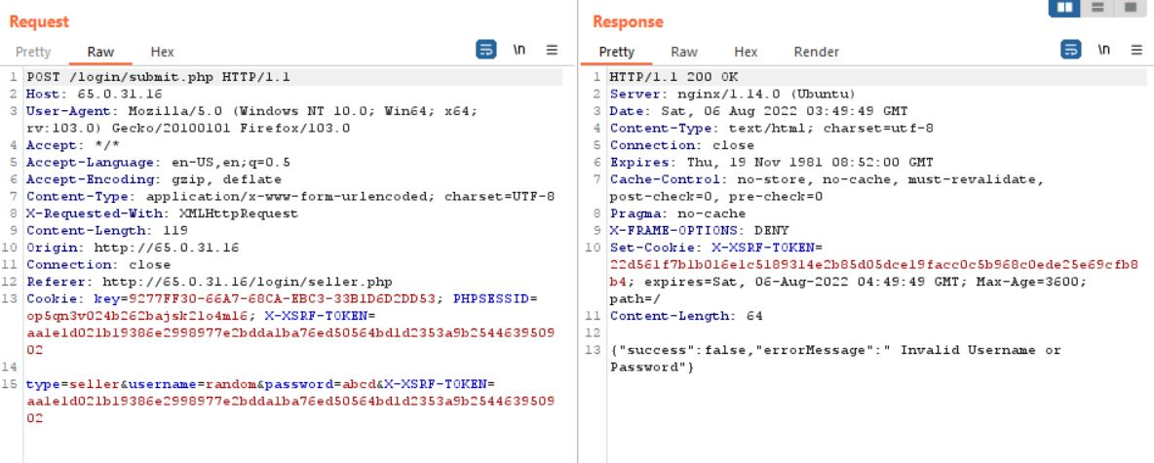
Observation

Slide 27
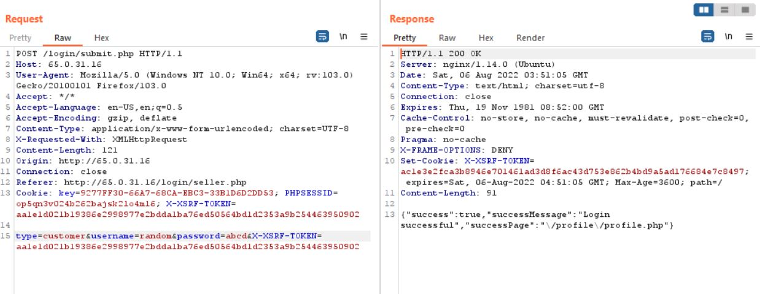
Observation

Slide 28
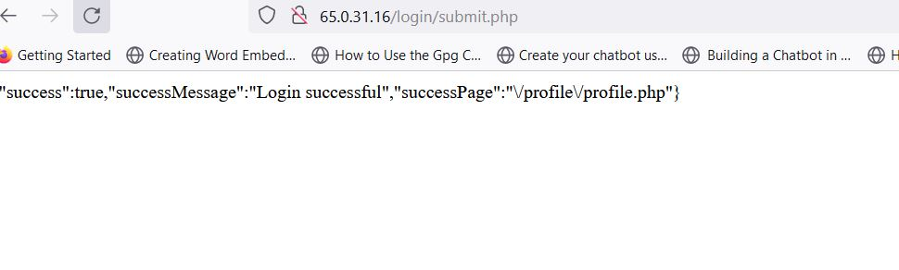
PoC

Slide 29
Business Impact – Extremely High
The impact of an insecure direct object reference vulnerability depends very much on the application's functionality. Therefore, a clear list can not be easily given. Generally speaking, an IDOR vulnerability can introduce a risk for CIA (confidentiality, integrity, availability) of data. Some impacts of a successful IDOR attack include: Unauthorized access to sensitive data – Object references often include database IDs, which attackers can access to expose sensitive information about the application/users.

Slide 30
Recommendation
Take the following precautions:
Sensitive information must only be accessible to authorised users
Implement proper authentication and authorisation checks at every function to make sure the user requesting access to a resource whether to view or edit is his own data and no one else's
Implement proper Rate Limiting checks that disallows large number of requests from/to a single resource. For example, if from a single device, a single module like OTP check, password check, signup, etc. is being called 100 times in a single minute, it should be blocked
Similarly, if an account’s password is being attempted to reset even from different devices, the account should be locked for a while. Implement these checks on the basis of IP addresses and sessions
References:
https://portswigger.net/web-security/access-control/idor

Slide 31
3. Brute forcing OTP Bypass for admin login and orders of customers
Admin Login Using OTP Bypass (Critical) | The below mentioned login page allows login via OTP which can be bruteforced Affected URL : http://65.0.31.16/reset_password/admin.php?otp=000 Affected Parameters : OTP (GET parameters)

Slide 32
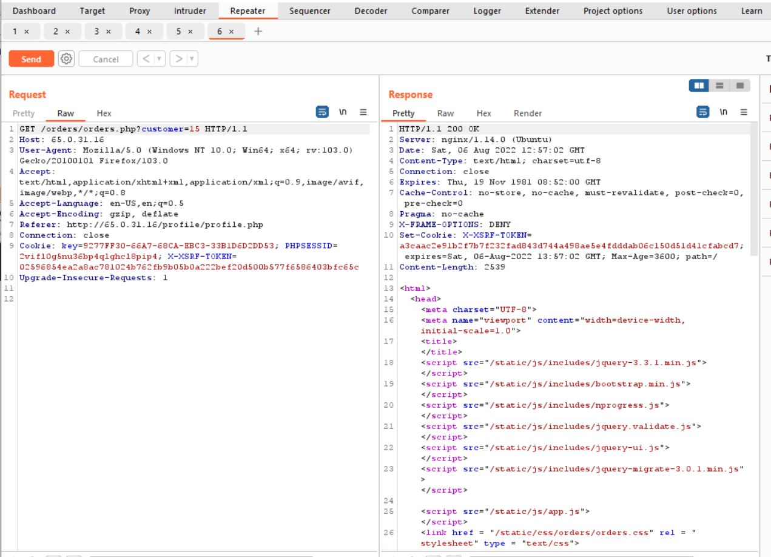
Observation

Slide 33
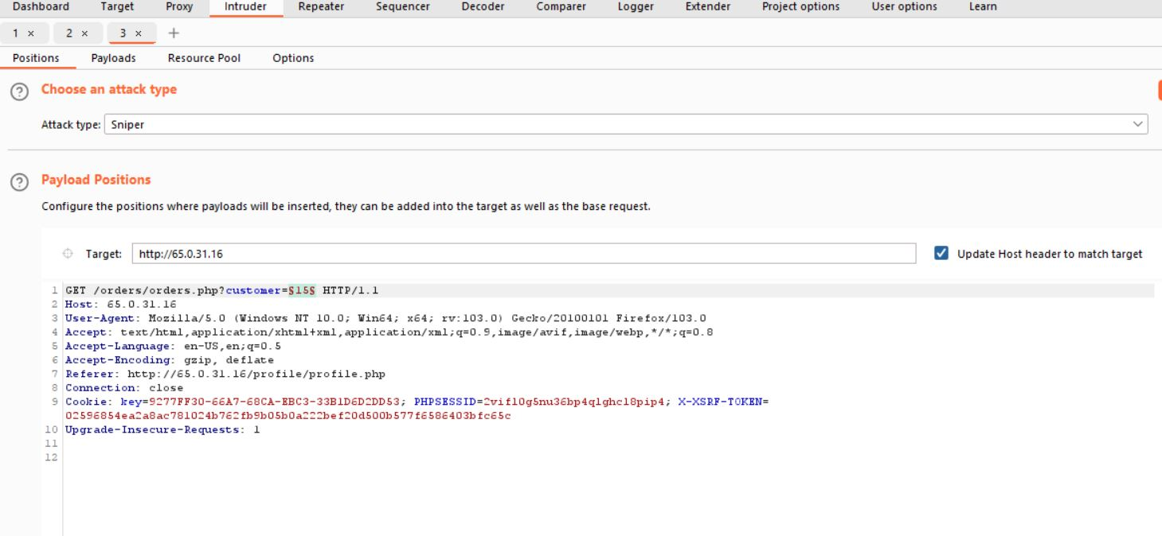
Observation

Slide 34
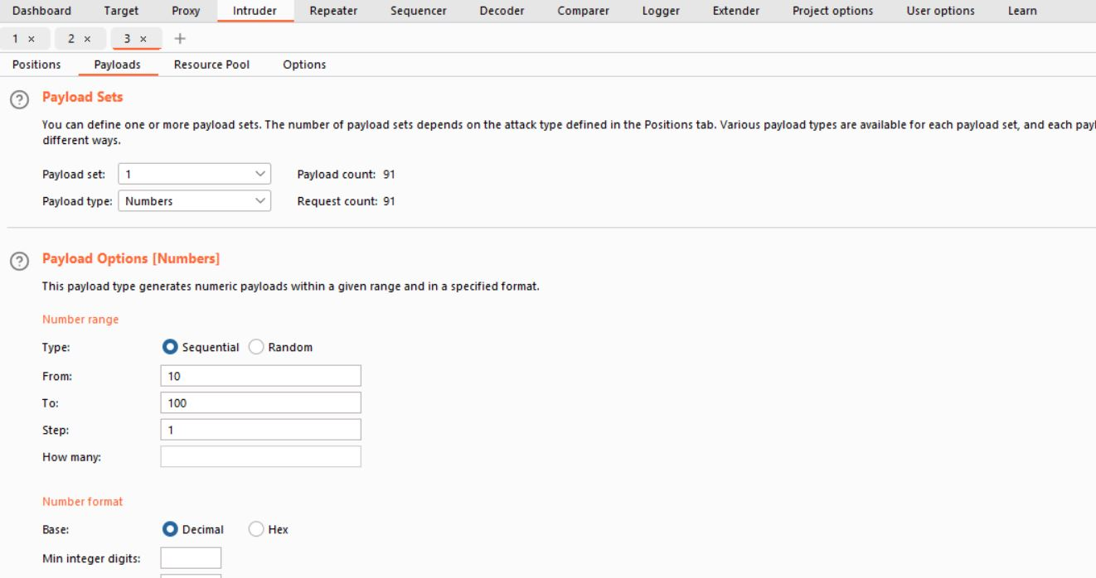
Observation

Slide 35
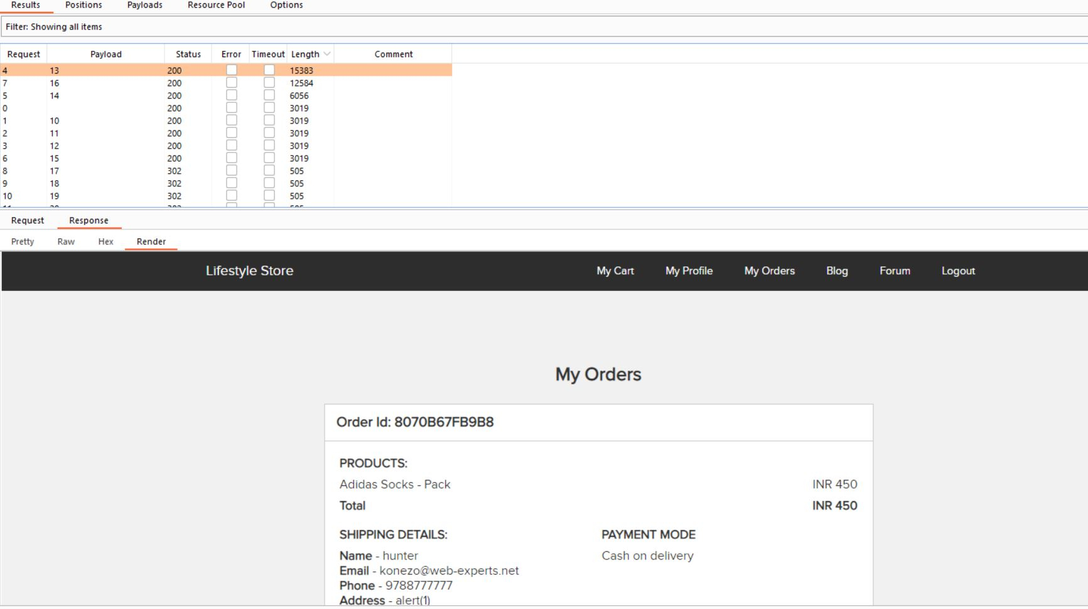
PoC

Slide 36
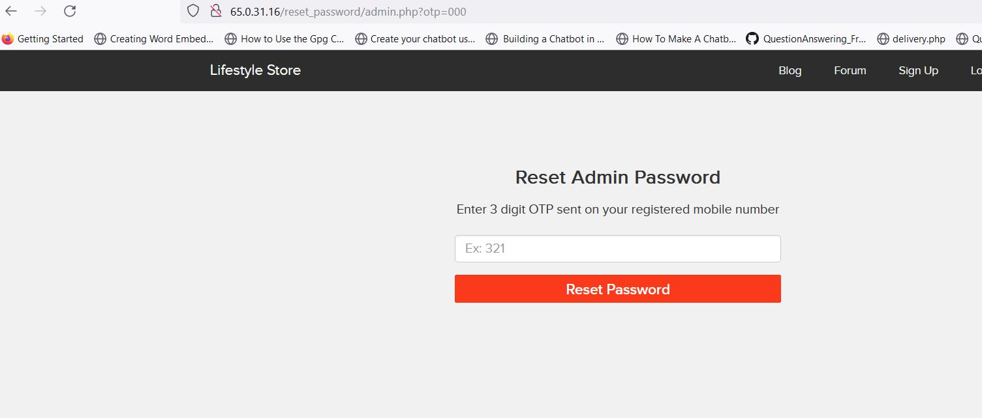
Observation

Slide 37
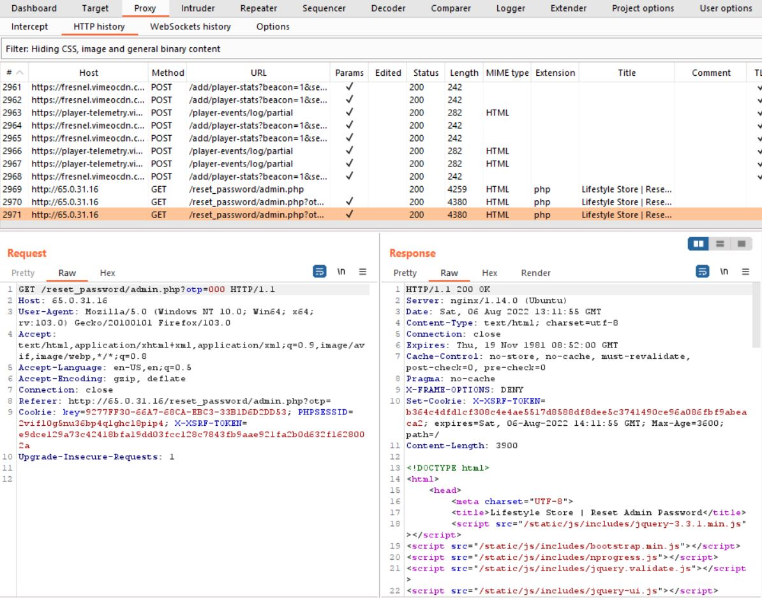
Observation

Slide 38
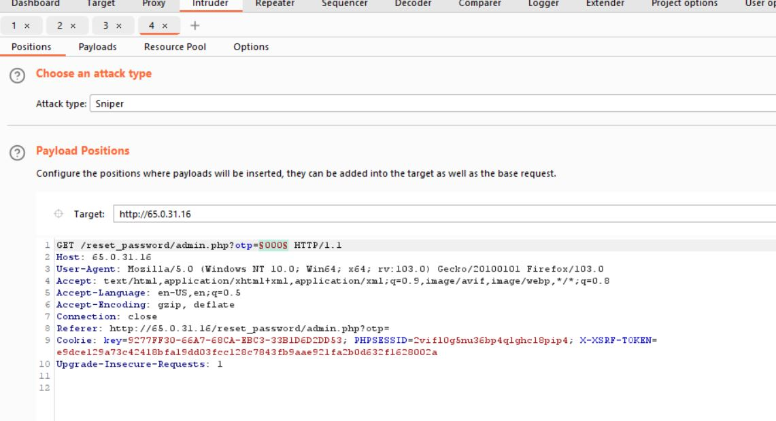
Observation

Slide 39
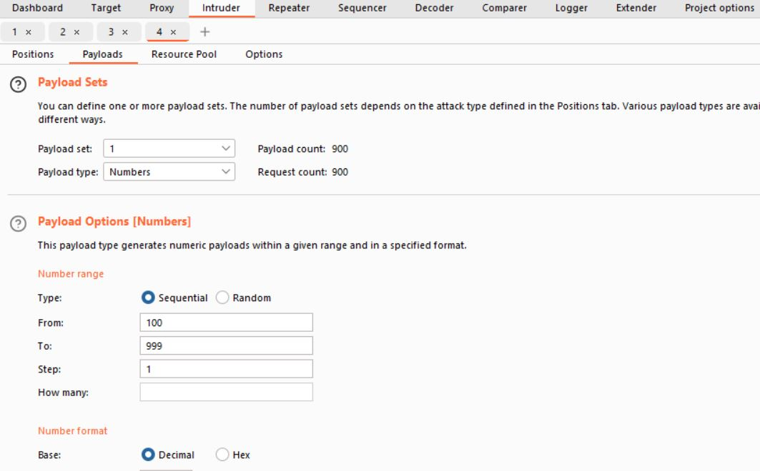
Observation

Slide 40
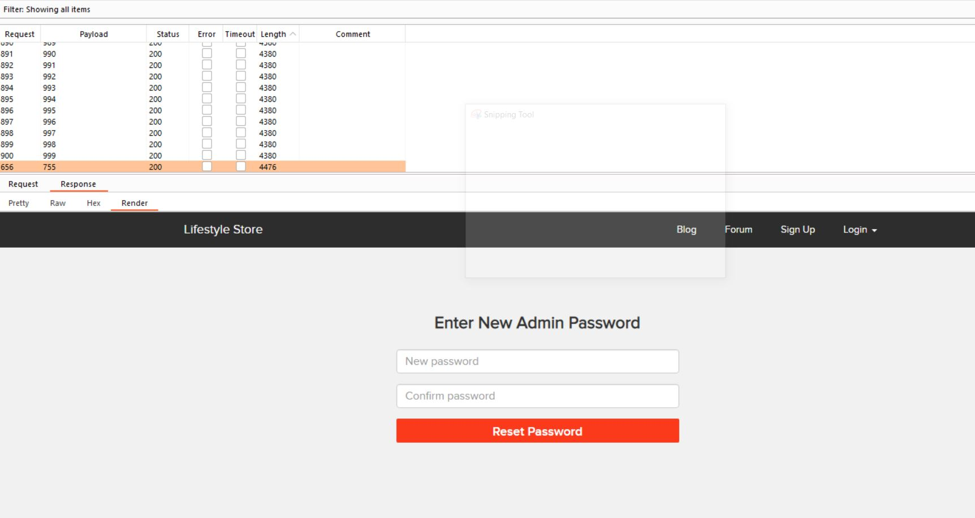
PoC

Slide 41
Business Impact – Extremely High
Identity theft – stealing someone’s identity to access their accounts, such as bank accounts or credit cards. This enables the attacker to purchase goods using these details. In addition, information such as social security numbers can be sold for use in other cyber attacks.
Loss of data – due to loss of confidentiality if data is stolen which could destroy company reputation. Additionally, there may be reputational damage caused by a leak of sensitive customer information that leads to public distrust and dissatisfaction with the business.
Downtime – this refers to system outages where websites or computer networks cannot be accessed due to a cyber attack. This is costly to the business in terms of lost revenue, customer satisfaction as well as loss of image.

Slide 42
Recommendation
Take the following precautions:
Use proper rate-limiting checks on the no of OTP checking and Generation requests
Implement anti-bot measures such as ReCAPTCHA after multiple incorrect attempts
OTP should expire after certain amount of time like 2 minutes
OTP should be at least 6 digit and alphanumeric for more security
References:
https://www.owasp.org/index.php/Testing_Multiple_Factors_Authentication_(OWASP-AT-009)
https://www.owasp.org/index.php/Blocking_Brute_Force_Attacks

Slide 43
4. Arbitrary File Upload allows all kinds of uploads
Arbitrary File Upload (Critical) | The Blog module suffers from an Arbitrary File Upload Vulnerability that allows attacker to upload any file Affected URL : http://65.0.31.16/wondercms/files/filevul.php Affected Parameters : files(POST parameters)

Slide 44
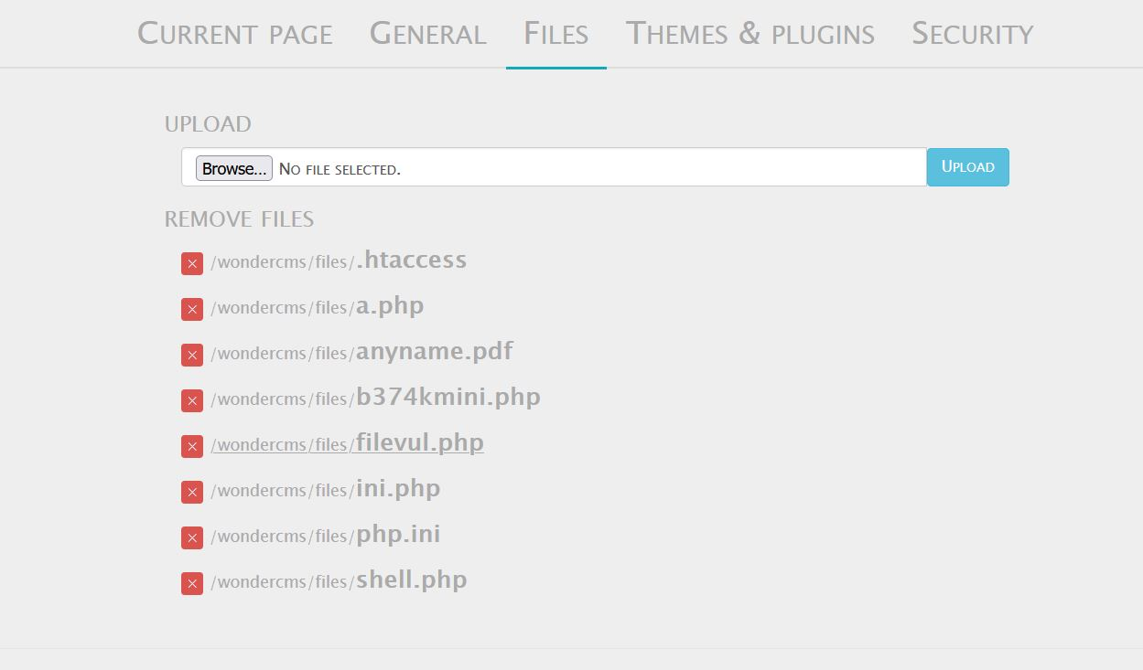
PoC

Slide 45
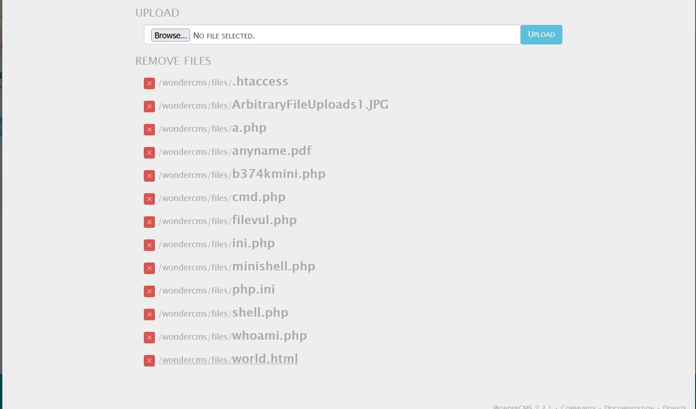
Observation

Slide 46
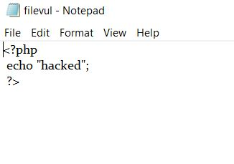
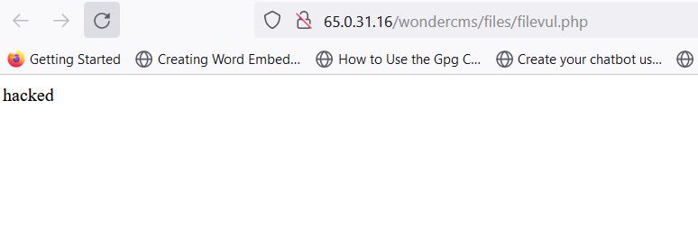
PoC

Slide 47
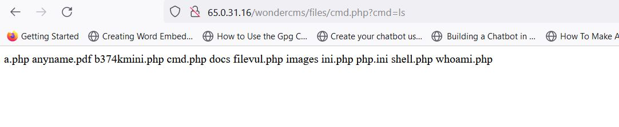
PoC

Slide 48
Business Impact – Extremely High
Using a file upload helps the attacker accomplish the first step. The consequences of unrestricted file upload can vary, including complete system takeover, an overloaded file system or database, forwarding attacks to back-end systems, client-side attacks, or simple defacement.
The hacker may upload phishing pages. ...
May grant access or host other illegal software objects that will increase the chance of further security risks.
The hacker may gain control of the webserver and modify the website to remove useful pieces of data.

Slide 49
Recommendation
Take the following precautions:
Perform proper server-side validations on what kind of a file user is uploading
Use white lists filters instead of black list filters. Example: in case of a resume upload feature, instead of banning PHP and .exe files, only allow .pdf, .doc and .docx files
Rename the files using a code, so that the attacker cannot play around with file names
Use static file hosting servers like CDNs and file clouds to store files instead of storing them on the application server itself
References:
https://owasp.org/www-community/vulnerabilities/Unrestricted_File_Upload
https://portswigger.net/web-security/file-upload

Slide 50
5. Exploiting Known Vulnerabilities of wondercms
Exploiting Known Vulnerabilities of wondercms (Critical) | Below mentioned parameters are vulnerable to known vulnerabilities Affected URL : http://3.108.223.109/wondercms/

Slide 51
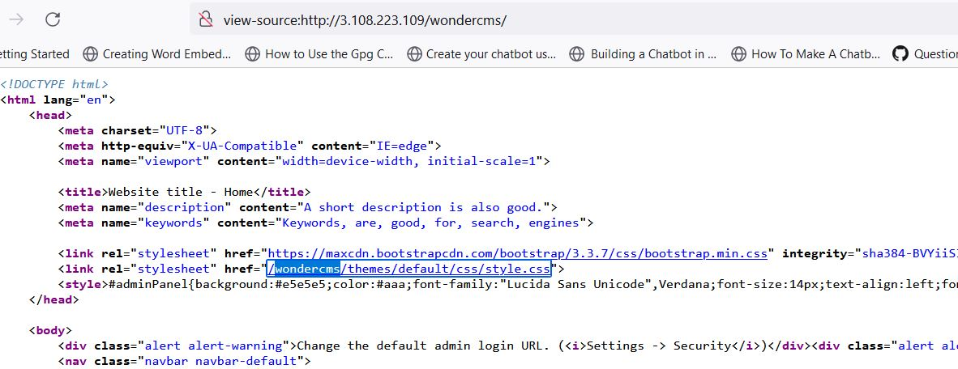
Observation

Slide 52
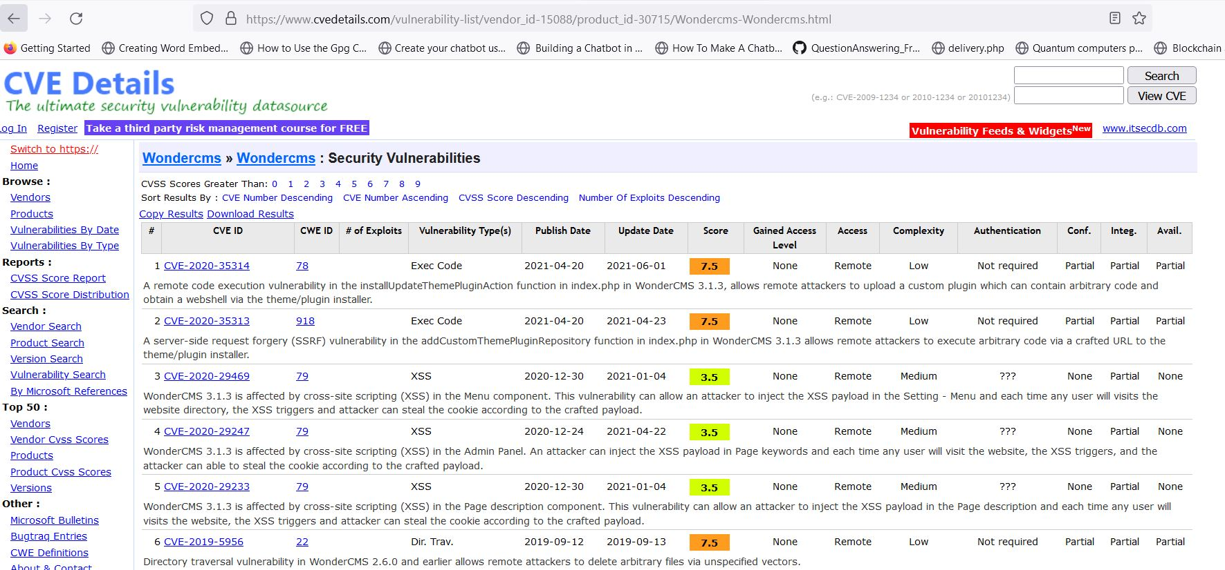
Observation

Slide 53
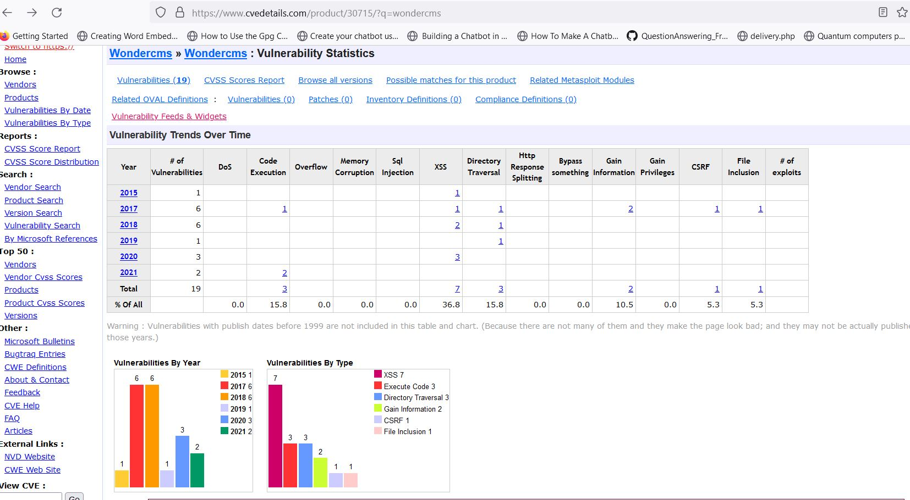
Observation

Slide 54
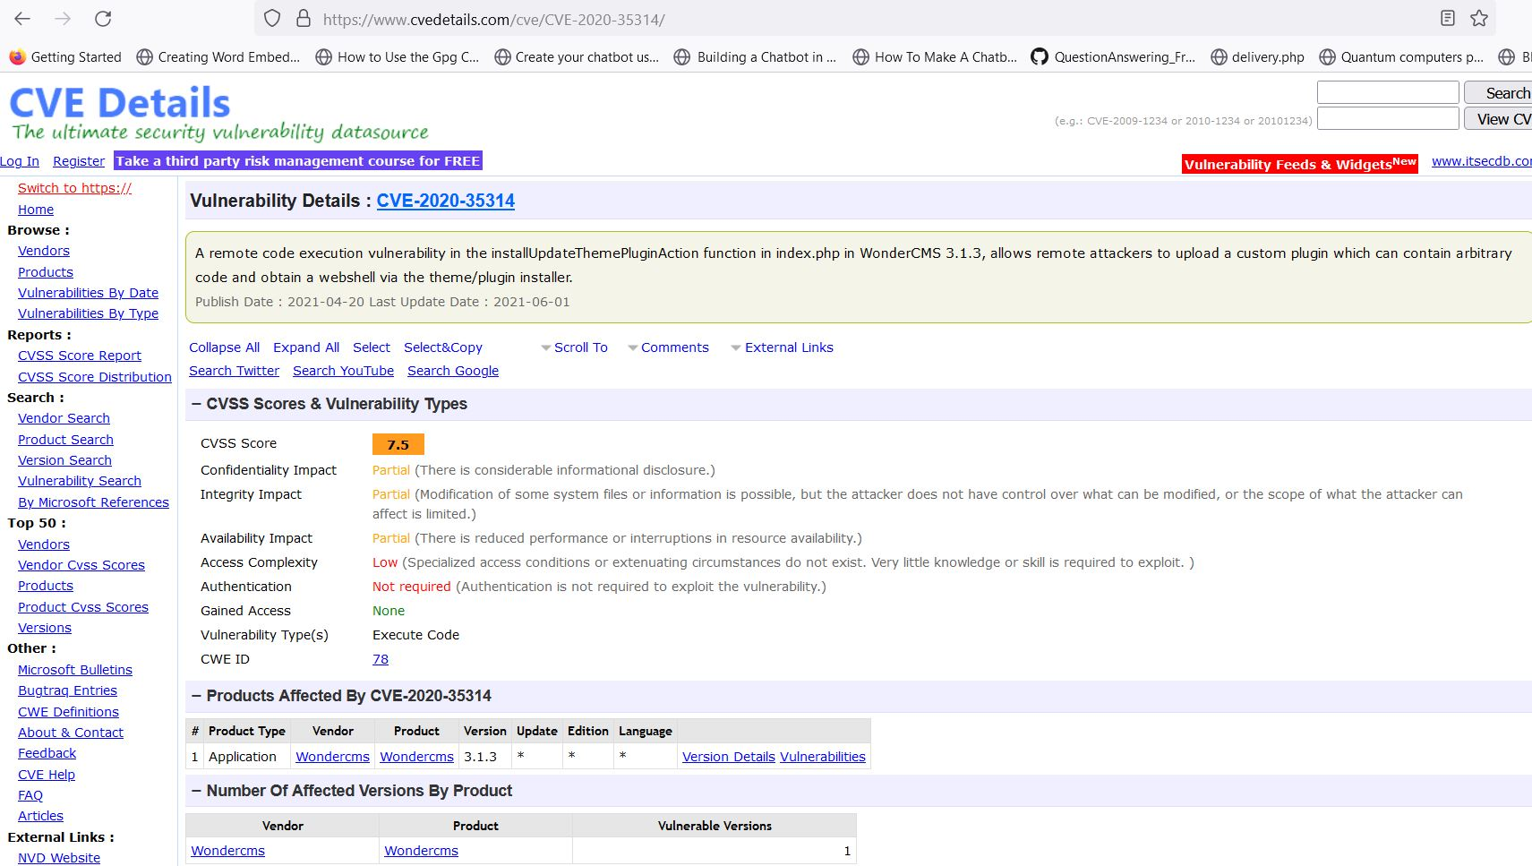
Observation

Slide 55
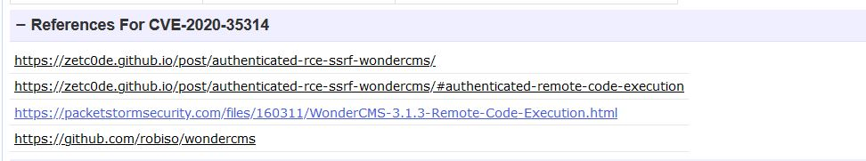
Observation

Slide 56
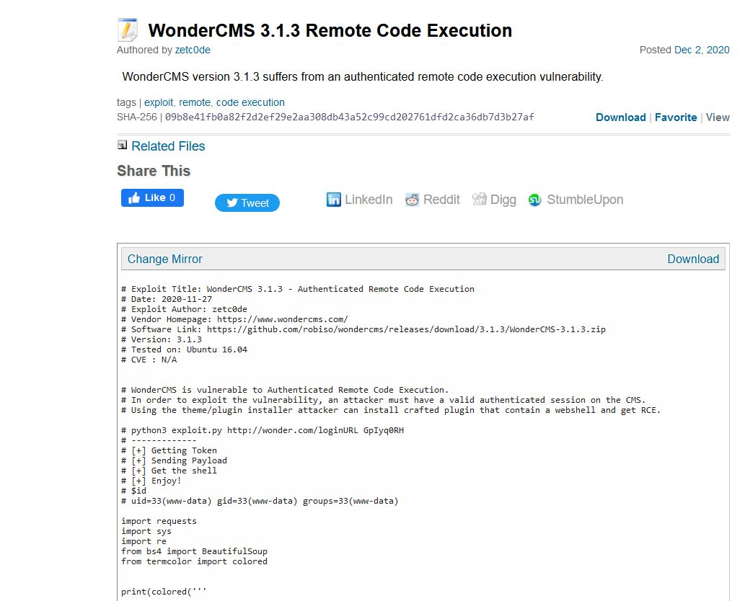
Observation

Slide 57
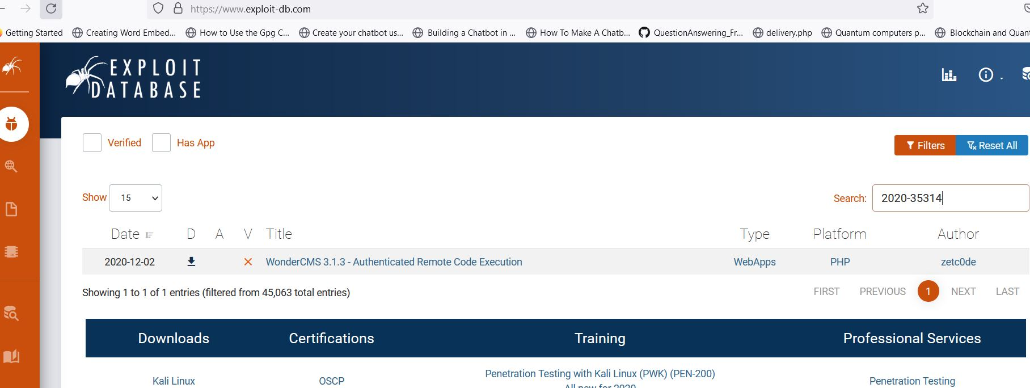
Observation

Slide 58
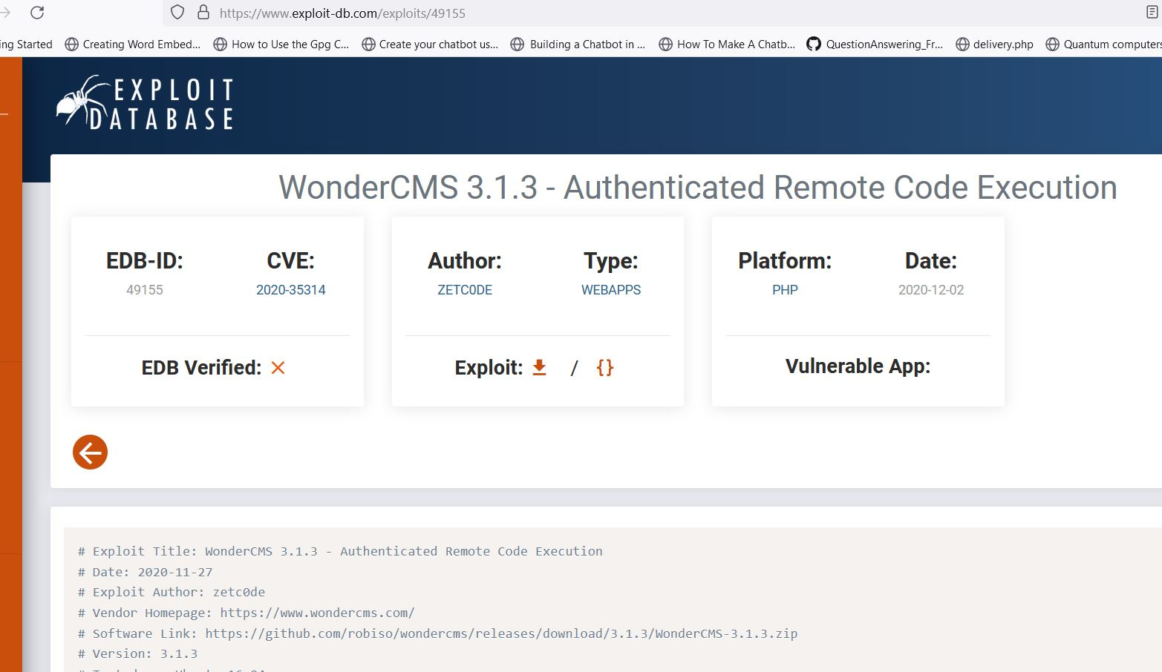
Observation

Slide 59
Business Impact – Extremely High
The most damaging vulnerabilities. If successfully exploited, an attacker can: Take total control of the affected device, and data stored on it. Use the program or device to launch attacks on other devices connected to it, expanding the circle of potential damage. In cybersecurity, a vulnerability is a weakness that can be exploited by cybercriminals to gain unauthorized access to a computer system. After exploiting a vulnerability, a cyberattack can run malicious code, install malware and even steal sensitive data.

Slide 60
Recommendation
Take the following precautions:
Upgrade to the latest version of Affected Software/theme/plugin/OS which means latest version number
If upgrade is not possible for the time being, isolate the server from any other critical data and servers
References:
https://www.cisa.gov/known-exploited-vulnerabilities-catalog

Slide 61
6. Cross Site Request Forgery
Cross Site Request Forgery (Severe) | Below mentioned parameters are vulnerable to cross site request forgery Affected URL : http://65.0.31.16/profile/16/edit/

Slide 62
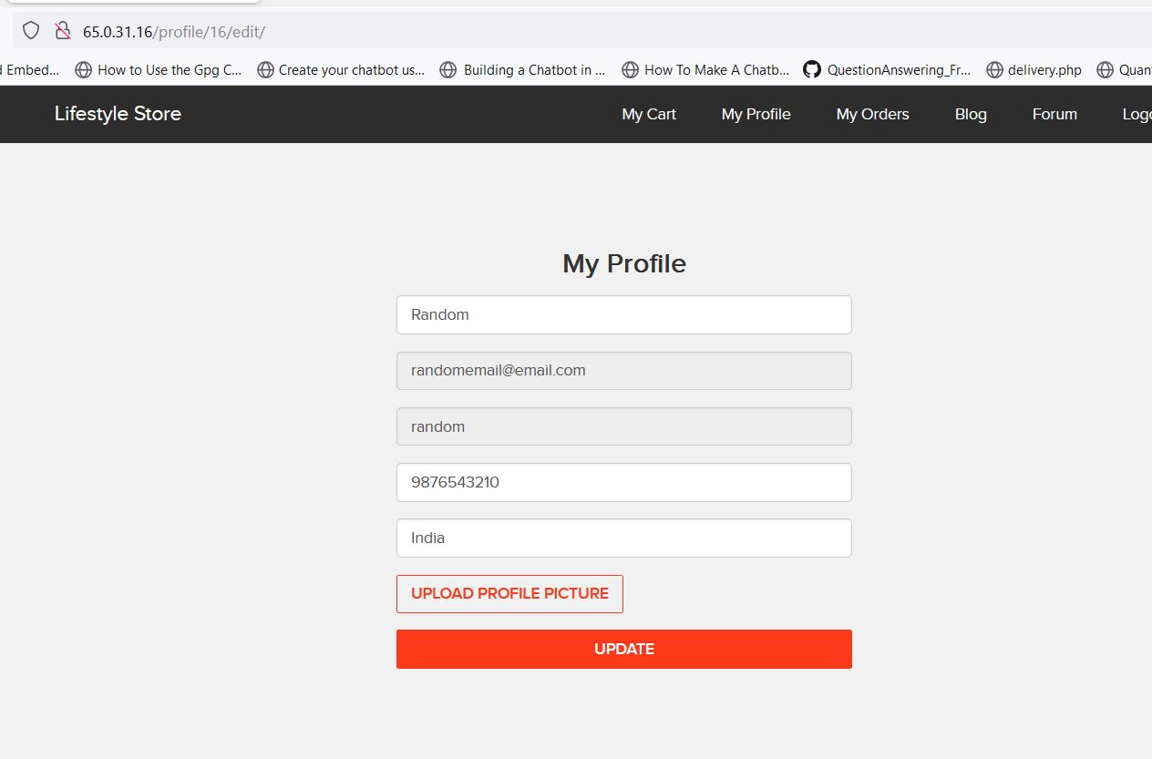
Observation

Slide 63
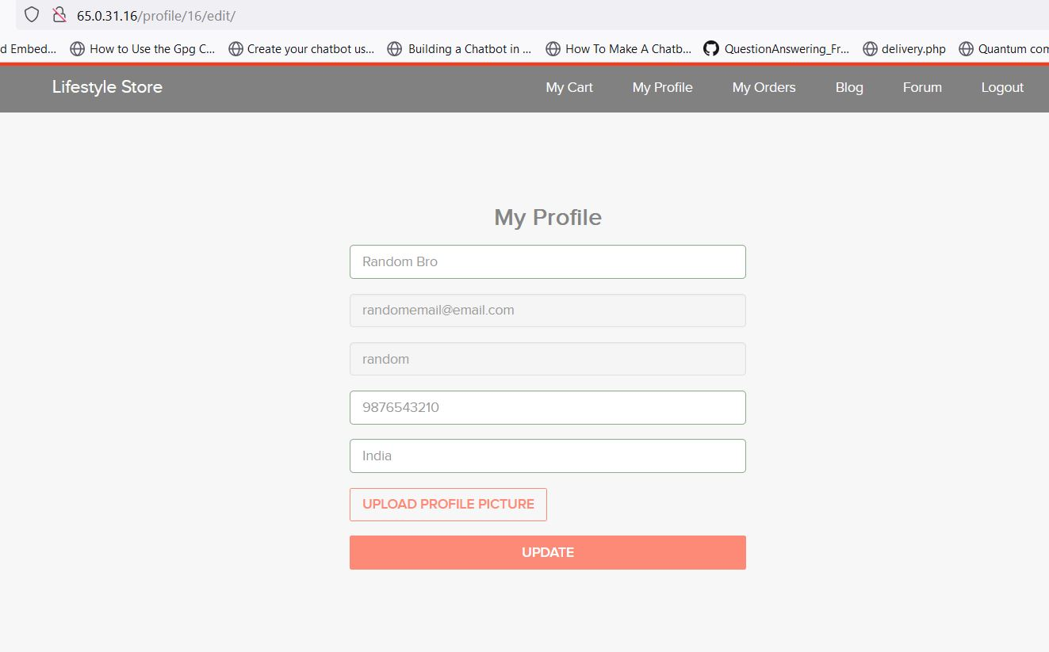
Observation

Slide 64
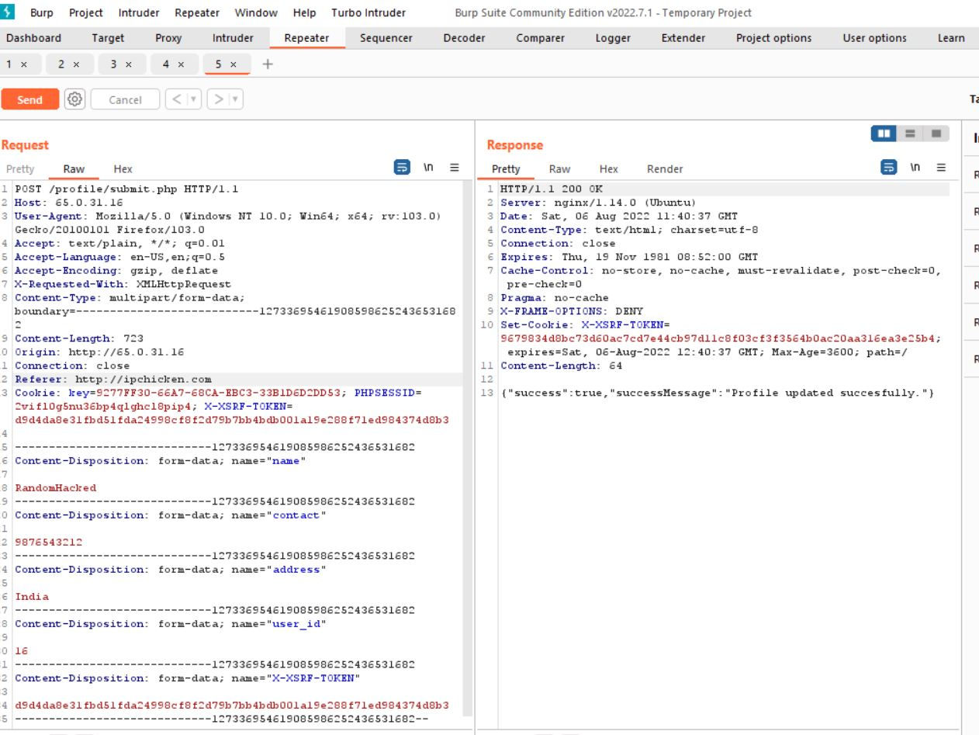
Observation

Slide 65
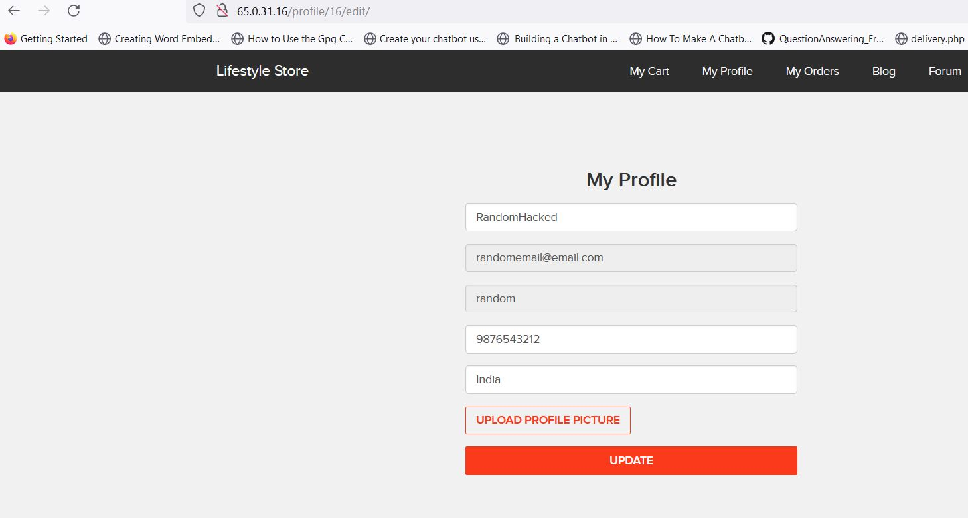
PoC

Slide 66
Business Impact – Severe
In a successful CSRF attack, the attacker causes the victim user to carry out an action unintentionally. For example, this might be to change the email address on their account, to change their password, or to make a funds transfer. Depending on the nature of the action, the attacker might be able to gain full control over the user's account. If the compromised user has a privileged role within the application, then the attacker might be able to take full control of all the application's data and functionality.

Slide 67
Recommendation
Take the following precautions:
Ask the user his password (temporary like OTP or permanent like login password) at every critical action like while deleting account, making a transaction, changing the password etc.
Implement the concept of CSRF tokens which attach a unique hidden password to every user in every <form>. Read the documentation related to the programming language and framework being used by your website
Check the referer before carrying out actions. This means that any action on x.com should check that the HTTP referrer is https://x.com/* and nothing else like https://x.com.hacker.com/*
References:
https://portswigger.net/web-security/csrf

Slide 68
7. Rate Limiting Flaws for customer info
Rate Limiting Flaws for customer info (Severe) | Below mentioned urls are vulnerable to rate limiting flaws: Affected URL : http://65.0.31.16/orders/orders.php?customer=16

Slide 69
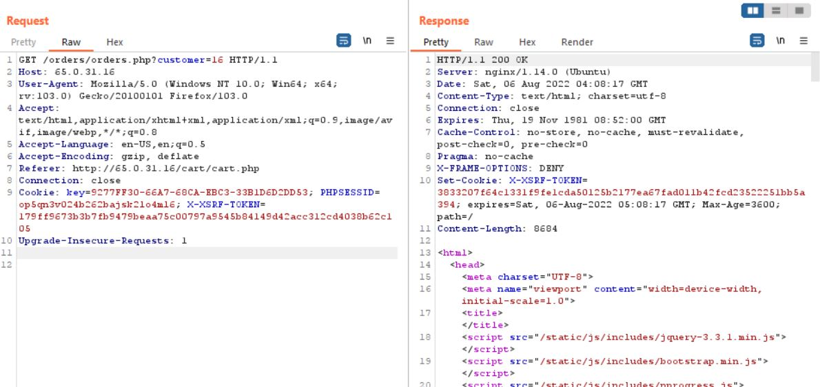
Observation

Slide 70
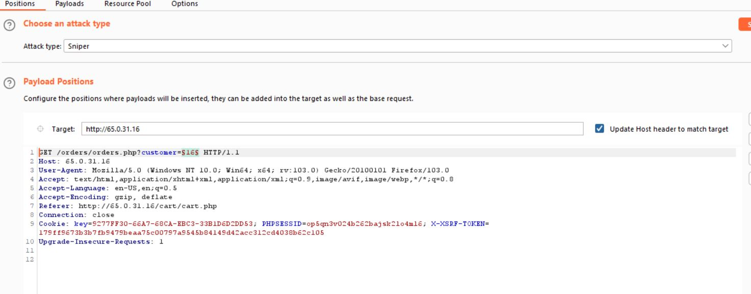
Observation

Slide 71
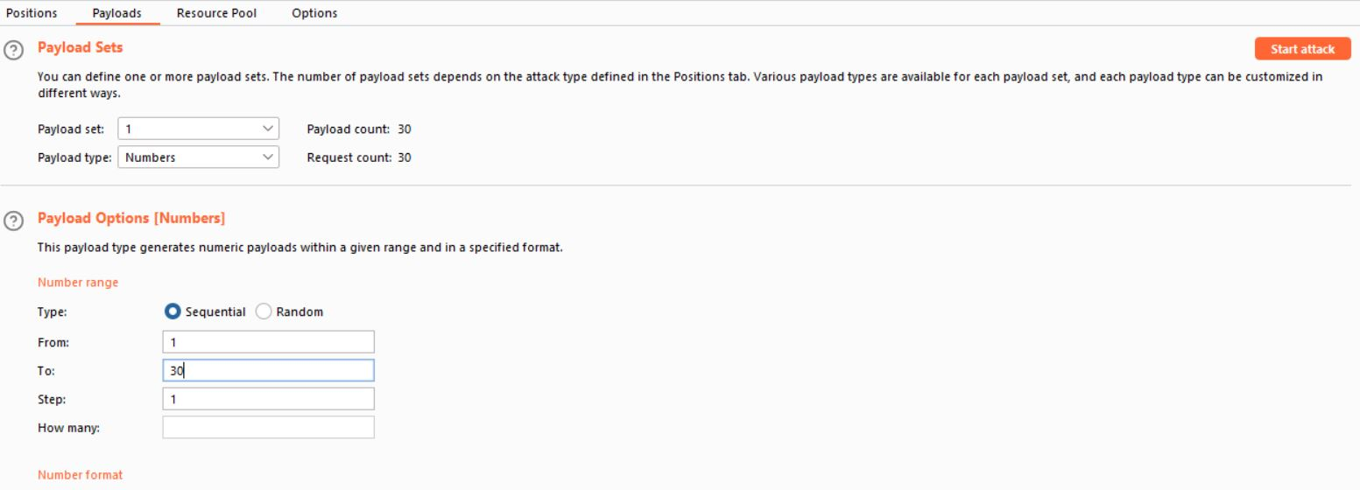
Observation

Slide 72
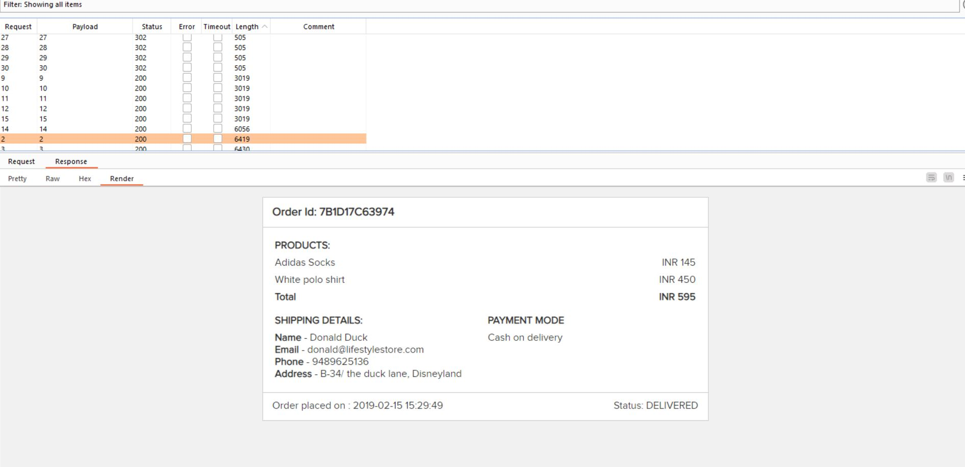
PoC

Slide 73
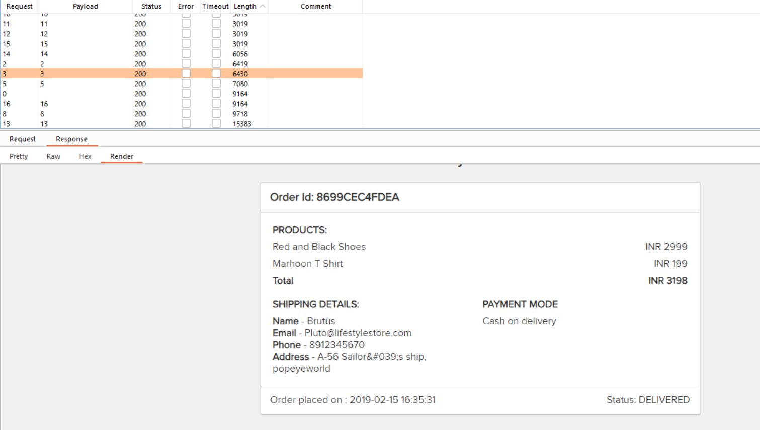
Observation

Slide 74

Observation

Slide 75

Observation

Slide 76

Observation

Slide 77
Business Impact - Severe
Turning away visitors: Rate limiting restricts the number of connections to the website, which – in turn – restricts the number of visitors to the website. Above a certain traffic threshold, all new connections will be blocked.
Decreasing conversion rates: Rate limiting will not only stop new visitors from reaching your website, but will also slow down visitors who are already on your website.
Doesn’t stop the bad guys: Finally, it needs to be pointed out that rate limiting doesn’t actually stop bad traffic from reaching your website. Rate limiting – as the name implies – limits the rate of incoming connections. It is a brute-force mechanism for capping the amount of total traffic.

Slide 78
Recommendations
Don’t request more than one access token every 20 minutes: Requesting lots of tokens in a short time period, such as for every API request, doesn’t offer a performance advantage and can cause rate-limiting. Instead, consider caching the token and reusing it until it expires.
Use the expires_in token response parameter: When you request an access token using OAuth 2.0, the expires_in response parameter returns the length of time in seconds that the access token is valid. Request a new token based on the time returned. For example, based on the value returned in the expire_in response parameter, you can refresh an access token or request a new token five minutes before the token expires.
Use offline scope: For web and public app integrations, offline scope allows you to refresh a token even without an active user session. With offline scope, you can renew an access token that is expired or about to expire. Offline scope works by using a valid refresh token, which has a longer lifetime.

Slide 79
8. Default Files Access
Default Files Access (Moderate) | Below mentioned URL in the Lifestyle Store module is vulnerable to Default files Affected URL : http://3.108.223.109/

Slide 80

Observation

Slide 81

Observation

Slide 82

Observation

Slide 83

Observation

Slide 84
Business Impact - Moderate
Once a flaw is discovered, the consequences of a flawed access control scheme can be devastating. In addition to viewing unauthorized content, an attacker might be able to change or delete content, perform unauthorized functions, or even take over site administration.

Slide 85
References
https://owasp.org/www-project-top-ten/2017/A5_2017-Broken_Access_Control

Slide 86
9. SQL Injection
SQL Injection (Moderate) | Below mentioned URL in the Shop Now Search module is vulnerable to SQL injection attack Affected URL : http://3.108.223.109/search/search.php? Affected Parameters : Socks (POST parameter) Payload: Socks’ or ‘1’=‘1

Slide 87

Observation

Slide 88

PoC

Slide 89
Business Impact - Moderate
The impact SQL injection can have on a business is far-reaching. A successful attack may result in the unauthorized viewing of user lists, the deletion of entire tables and, in certain cases, the attacker gaining administrative rights to a database, all of which are highly detrimental to a business.

Slide 90
Recommendation
Take the following precautions to avoid exploitation of SQL injections:
Sanitise user input and remove or encode special characters like ‘ “ - () # etc.
Use whitelist filters, which means if a parameter is supposed to have integer values, do not allow non-numeric input. If it is an email field, allow alphanumerics, @ and .(dot)
Use strong web application firewalls to make exploitation difficult
Never run SQL server software (MySQL, MsSQL, etc.) as high privilege user such as ‘root’
Use prepared statements for SQL queries instead of inserting user controlled input into SQL queries
Remove default databases and accounts such as test, guest, admin, etc.

Slide 91
References
https://www.owasp.org/index.php/SQL_Injection
https://en.wikipedia.org/wiki/SQL_injection

Slide 92
10.Directory Listing of Configuration Files
Directory Listing of Configuration Files (Low) | Below mentioned URL in the Shop Now Search module is vulnerable to SQL injection attack Affected URL : http://3.108.223.109/profile/profile.php Affected Parameters : image (GET parameter)

Slide 93

Observation

Slide 94

Observation

Slide 95

PoC

Slide 96
Business Impact – Low
A directory listing is inappropriately exposed, yielding potentially sensitive information to attackers. A directory listing provides an attacker with the complete index of all the resources located inside of the directory. The specific risks and consequences vary depending on which files are listed and accessible.
Recommendation
Take the following precautions:
Configure your web server to prevent directory listings for all paths beneath the web root;
Place into each directory a default file (such as index.htm) that the web server will display instead of returning a directory listing.
References:
https://portswigger.net/kb/issues/00600100_directory-listing

Slide 97
THANK YOU
For any further clarifications/patch assistance, please contact: 9920663811

